Slide 1

Group 17
Kat Douglas
Omar Fuentes
Tracy Wilson
Soccernomics
Notes:
Tracy

Slide 2

GOOOOOOOOAL of this Project
Postulates soccer success of a nation can be attributed to :
GDP(Wealth)
Population size (Player Pool)
Experience (Passion for the game)
ELO
Created for Chess
Now used in many different sports
Notes:
Tracy

Slide 3
Data Sets
Kaggle
Game Data
OECD – (Organization for Economic Cooperation and Development)
Augment Population and GDP data from World Bank
Wikipedia.com
Fifa.com
ELO Data
Game Data
World Bank:
GDP
Population
EloRating.com
Individual Game Data
Rating Data
Notes:
Kat

Slide 4
Cleaning the Data
The best source of game data was from www.elorating.net
There was no easy download option. Data needed to be scraped year by year
Scraped from web site and pasted it into Excel.
Because of the way the data was formatted, we needed to transpose it into a single line
Wrote script to parse the ONE line and paste the selection into a new line
Found out that Excel has a limit of around 16,000 columns
Dates needed to be formatted because they all pasted in as 2018 dates
Minus signs needed to be converted for Excel to recognize negative numbers
Inconsistency in many countries - missing data
Disparate data sets
Sentiment changed to favorite sport and Generational Player
Getting to match between data sets
Countries disapearing, re appearing, renamed
Cut out countries that were too small to possibly qualify
Notes:
Kat

Slide 5
Feature Engineering
We added and took away from multiple data sets
Created:
Experience (Proprietary algorithm based on past success in WC)
ROC
Generational Player/Years
Fav Sport
Qualify/not Qualify
WCYear/not
Notes:
Kat

Slide 6
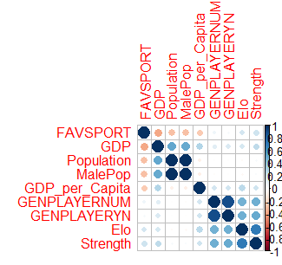
Variables Used
GDP
Population
Favorite Sport
Generational Player
Rank
Experience (Strength)
Male Population
GDP per Capita
Notes:
Kat

Slide 7
Linear Regression Model
Used StepAIC to determine best model
Created two models – all predictors and best model
R²s were vary similar on training sets:
56.232%
56.227%
Results of the test set were:
RMSE 113
53.11 % R-squared

Slide 8
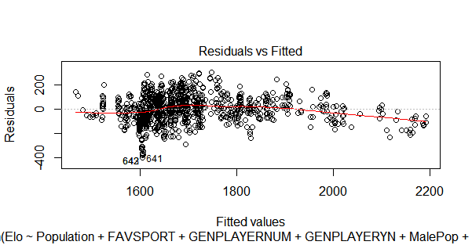
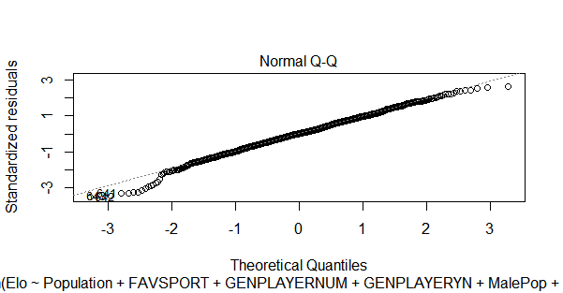
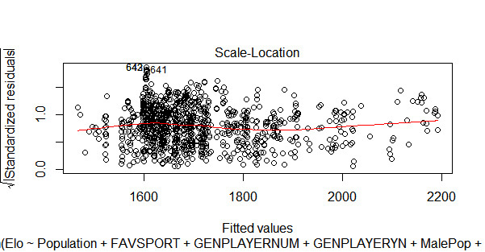
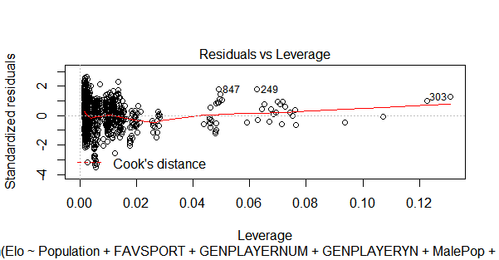
Notes:
Residuals vs. Fits Plot. When conducting aresidual analysis, a "residuals versus fits plot" is the most frequently created plot. It is a scatter plot ofresiduals on the y axis and fitted values (estimated responses) on the x axis. The plot is used to detect non-linearity, unequal error variances, and outliers.
The Q-Q plot, or quantile-quantile plot, is a graphical tool to help us assess if a set of data plausibly came from sometheoretical distribution such as a Normal or exponential. ... Here's an example of a Normal Q-Q plot when both sets ofquantiles truly come from Normal distributions.
A scale-location plot - This plot is similar to the residuals versus fitted values plot, but it uses the square root of the standardized residuals. ... A Cook's distance plot - Cook's distance is a statistic that tries to identify points which have more influence than other points.
Outliers: an outlier is defined as an observation that has a large residual. In other words, the observed value for the point is very different from that predicted by the regression model. Leverage points: A leverage point is defined as an observation that has a value of x that is far away from the mean of x.

Slide 9
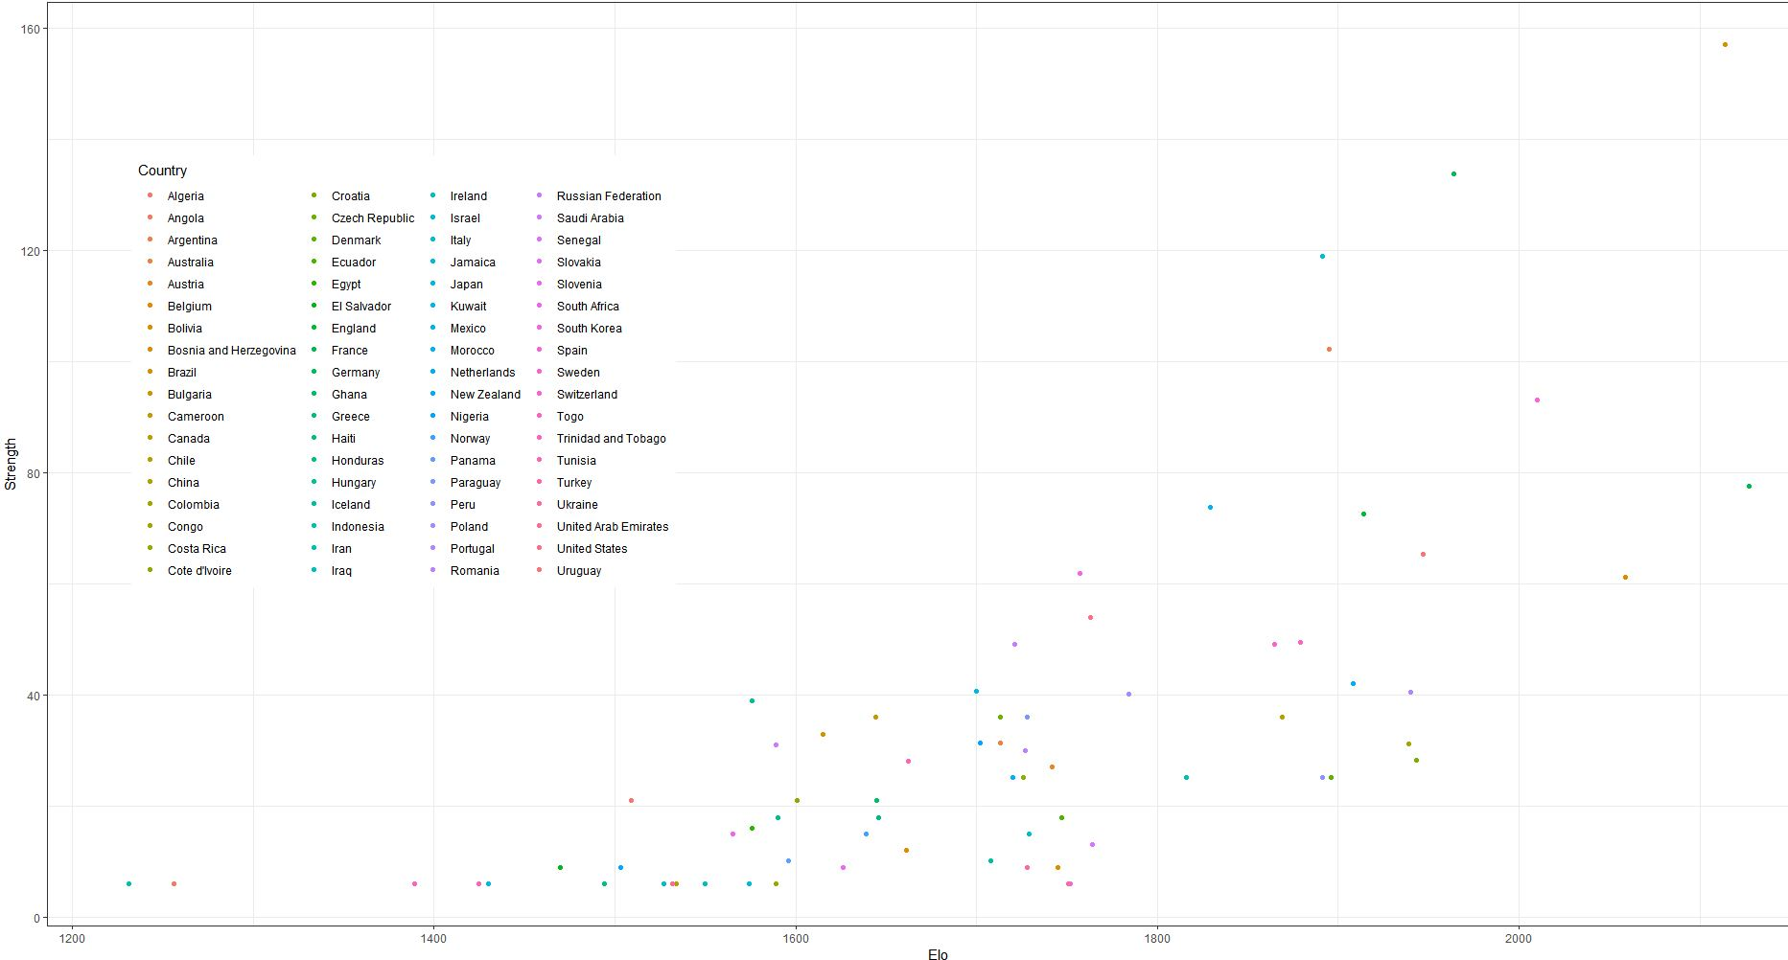
Experience vs. Elo

Slide 10
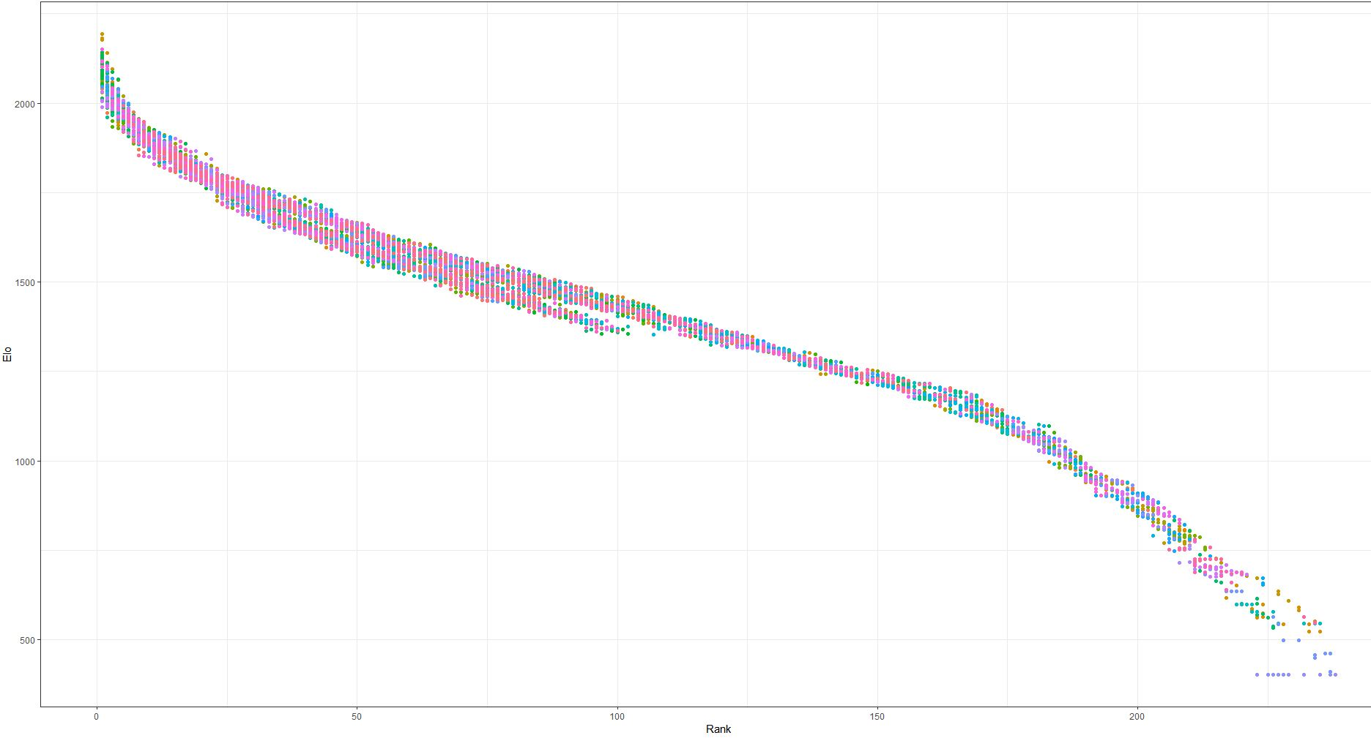
Rank vs. Elo

Slide 11
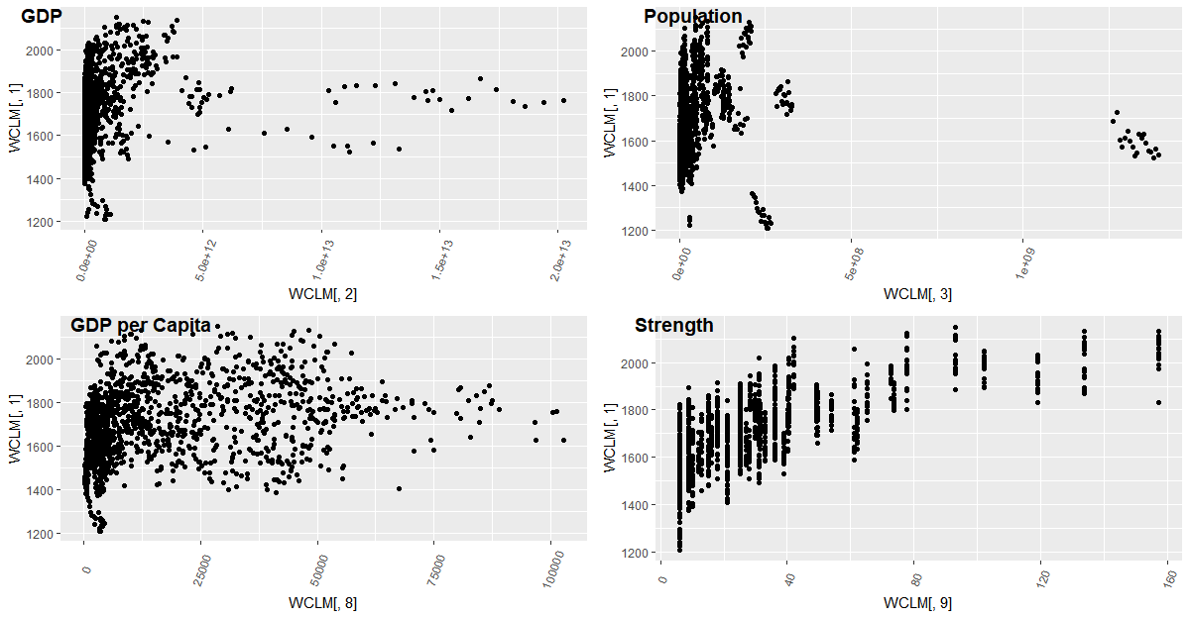
Elo vs. Predictors

Slide 12
10,000 or $15,000
10,000 hours – Practice makes perfect
Small apartments force poorer kids to spend more time outdoors
They don’t have funds to have expensive hobbies
Soccer is cheap – you need a ball
$15,000
Having a lot of free time won’t help if you are undernourished
Caveat: Poor means an annual income of at least $15,000
Notes:
Tracy - figure out what we want to do with this

Slide 13
Flow - we can have multiple of each , but we need at least one slide per point
Title - World Cup Success/Qualification - Book - does assumed predictors work?
The response var - ELO - what is it
Data sets that we used
Cleaning the data
Feature Engineering
Model options
Model tuning
Best performing model - based on what
Things we learned

Slide 14
Models Run - this can be more than one slide
Random Forest
RMSE 133
74.29 % R squared
Linear Regression - RSquared similar in optimal and all
RMSE 113
53.11 % R-squared
Rule Based
Notes:
Tracy - need to talk about how the r-squared is diff based on and Omar

Slide 15
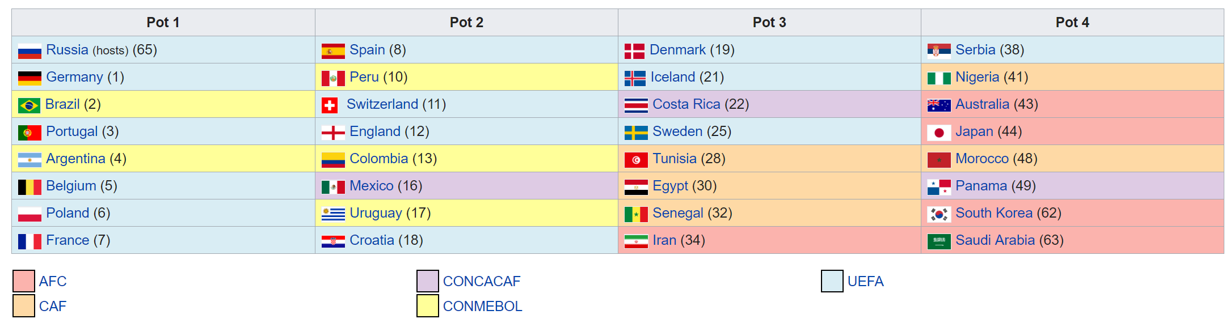
Traditional World Cup Qualifying

Slide 16
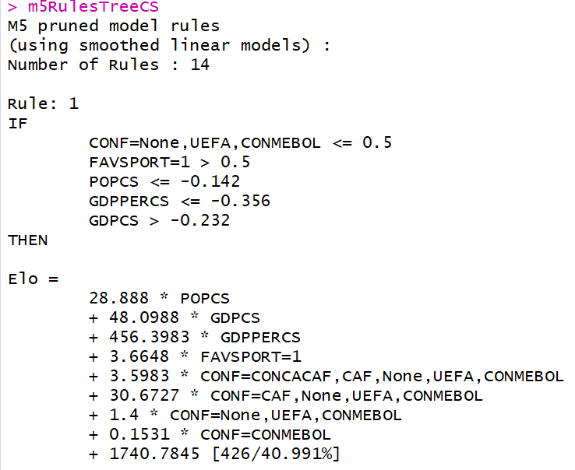
Rule – Based Tree Model
High Expectation
RMSE – 214.18 on test data ( 214 Elo points = Difference between #1 and #10)
Tuning Parameter - number of obs required to make new rule

Slide 17
Random Forest
Best Model
Centered and Scaled GDP, POP, and GDPPER
RMSE – 133.74 on test data (134 Elo points = Difference between #1 and #5 teams

Slide 18
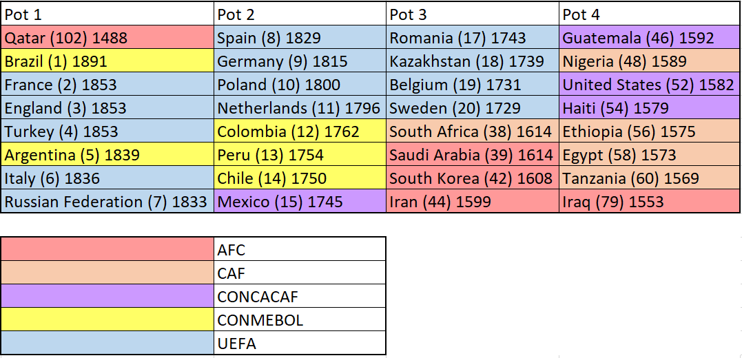
Qatar 2022

Slide 19
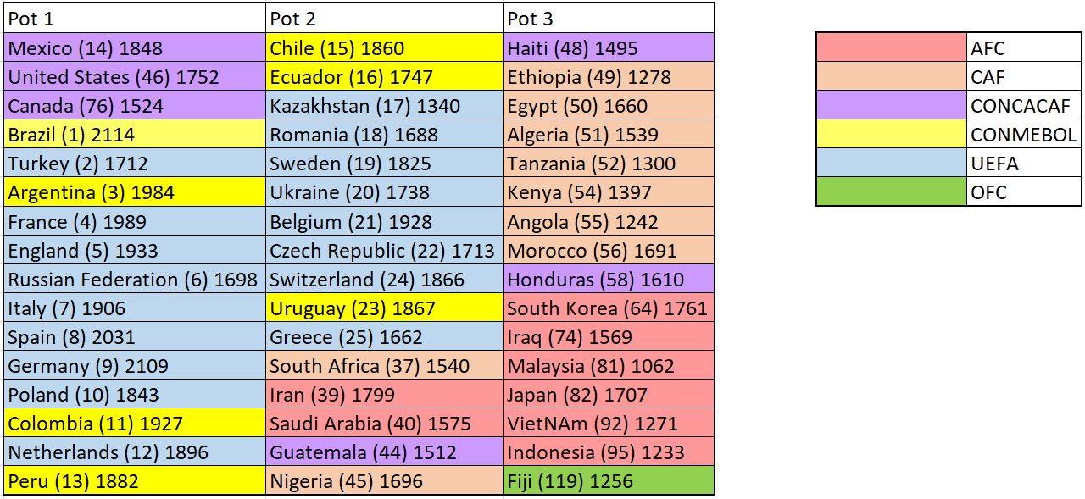
North America 2026

